Slide 1

PayCoin IC: Secure RlUSD Transactions on the Go
PayCoin IC is a web mobile interface designed for secure and easy cryptocurrency transactions. Focused on the RLUSD stablecoin on the XRPL blockchain, our solution prioritizes user experience and accessibility. We aim to streamline transactions via QR code scanning for seamless mobile use.

Slide 2


The XRPL Blockchain: Powering Our Payment Solution
XRPL offers speed, security, and scalability, ideal for financial applications. Its eco-friendly consensus mechanism is energy-efficient and it provides the robust infrastructure for secure RLUSD transactions. PayCoin IC leverages XRPL's capabilities for optimal performance and reliability.
1
Scalability
2
Security
Transaction with XRPor RlUSD
Protects against fraud and hacking.
3
Efficiency
Handles high transaction volumes.

Slide 3

Introducing the RLUSD Stablecoin
RLUSD is a stablecoin pegged to the US dollar on the XRPL. This minimizes volatility and ensures predictable transaction values. RLUSD offers a reliable medium for digital payments. PayCoin IC uses RLUSD to provide stability to users in their daily transactions.
Stability
Liquidity
Accessibility
Pegged to the US dollar for price stability.
Easily convertible to other cryptocurrencies or fiat.
Low barriers to entry for new users.

Slide 4
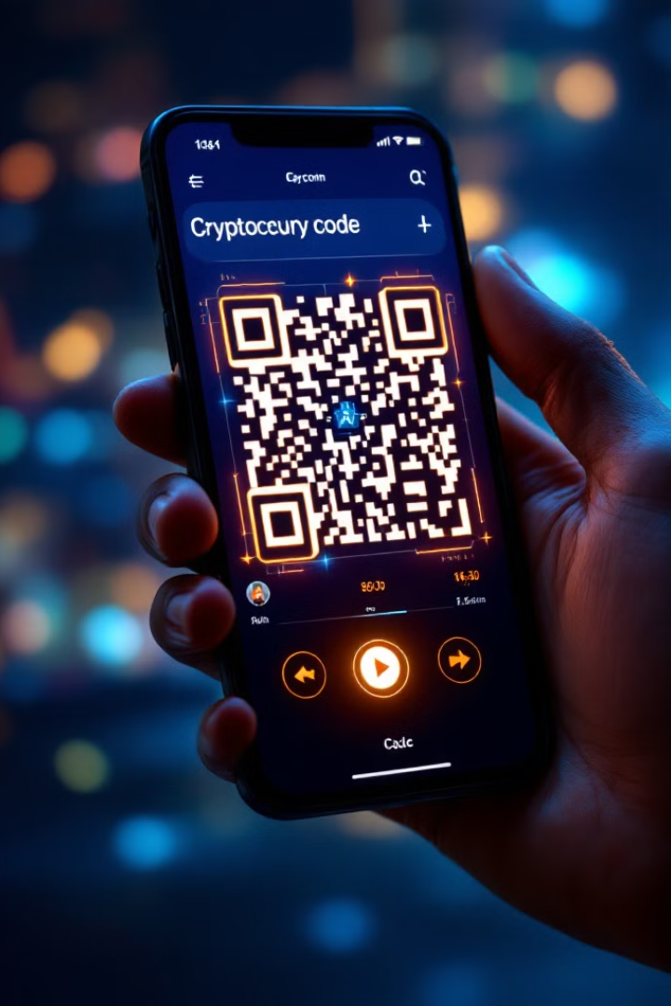
Effortless Transactions with QR Code Scanning
QR codes streamline payment, eliminating manual address entry. Users can initiate transactions instantly by scanning a QR code. This reduces errors and accelerates the payment process. PayCoin IC uses QR code scanning to make transactions simpler.
1
Scan
Scan the QR code with your device.
2
Confirm
Verify the transaction details.
3
Transact
The payment is completed securely.

Slide 5




Intuitive Web Interface for Mobile Devices
PayCoin IC is optimised for mobile, ensuring seamless experience on smartphones. A user-friendly design simplifies navigation and transaction management. Access your crypto anytime, anywhere with PayCoin IC. We focus on ease of use for a broad audience.
Security
Mobile-Friendly
Speed
Safe and secure transactions.
Optimized for mobile devices.
Fast payment processing.

Slide 6
Enhancing Financial Accessibility and Inclusion
PayCoin IC aims to bridge the financial gap for underserved communities. Low transaction fees and easy access make crypto payments viable for everyone. We promote financial inclusion by providing accessible digital payment options. This empowers users and drives economic growth.
Low Fees
Global Reach
Reduces financial barriers.
Enables cross-border transactions.

Slide 7




Building Trust and Transparency in Crypto Payments
Transparency is key to establishing trust in digital transactions. Blockchain technology ensures all transactions are recorded immutably. PayCoin IC provides clear audit trails and enhances user confidence. We promote transparency and security in crypto payments.
Verification
Recording
Security
Transaction details are verified.
The transaction is recorded on the blockchain.
Ensuring security and trust for users.

Slide 8



Conclusion: The Future of Seamless Crypto Transactions
PayCoin IC offers a user-friendly, secure, and accessible platform for RLUSD transactions. By leveraging XRPL and QR codes, we streamline payments. Join us in shaping the future of crypto payments. Our focus on innovation drives financial inclusion and empowers users.
1
Adoption
2
Innovation
3
Accessibility

